Slide 1

PRESENTATION TITLE
Project 4 Group 7 : Spotify Data Analysis
Caroline Badocha, Robbie Hockley & Angela Alexander Smith
Month
20XX
Presentation Tagline
This Photo by Unknown Author is licensed under CC BY-NC-ND

Slide 2

BACKGROUND
Using the linked dataset🎹 Spotify Tracks Dataset | Kaggle we aim to answer the following questions and provide a range of visualizations:
1. How does Genre impact popularity?
2. How does Length of Song impact popularity?
3. What other attributes impact a song's popularity?
We then utilized this data to complete predictions for the future and host our visualizations on Tableau Public
We found a few limitations to the dataset including that there were multiple songs that were incorrectly genred and that there were some records that the tempo did not seem to be accurate based on our assessment of the genre

Slide 3

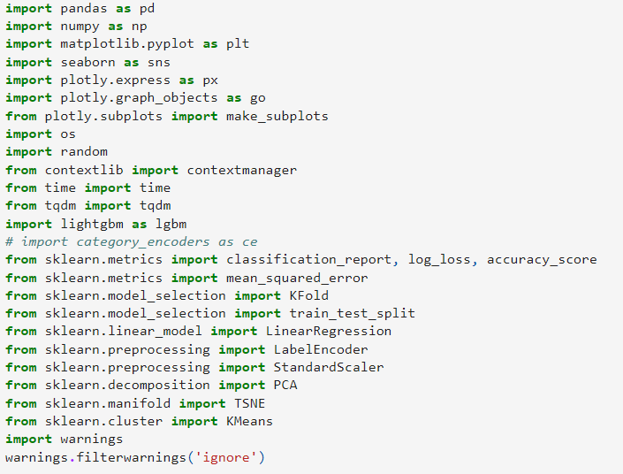
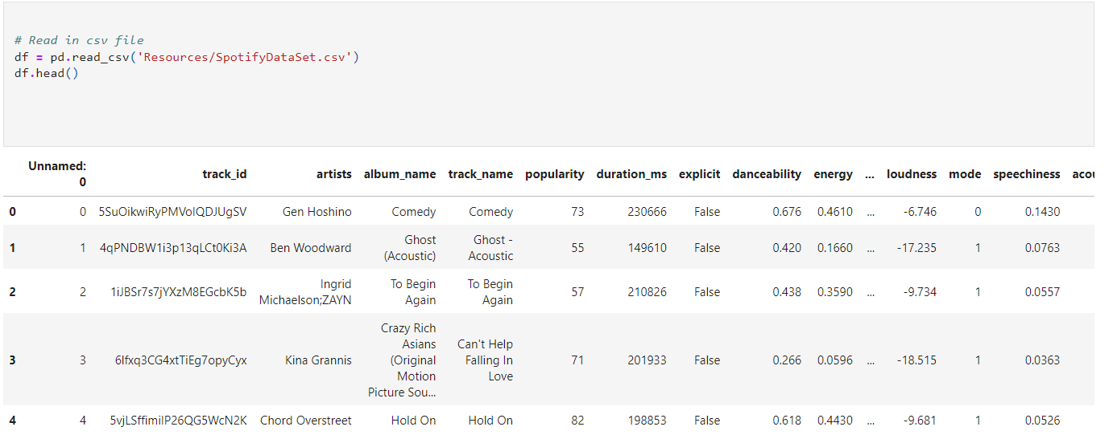
We imported the following dependencies:
And then read in the data set into our Jupyter Notebook:

Slide 4
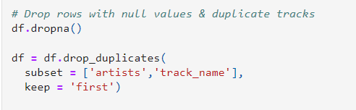
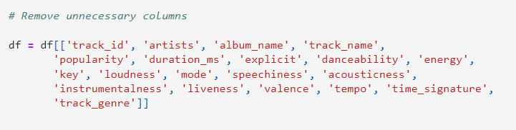
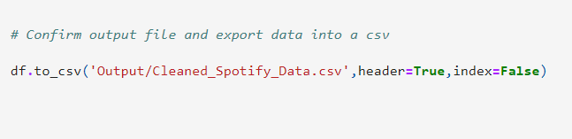
We then completed data cleaning on the original dataset to drop na values and duplicated data as well as removing unnecessary columns before outputting this to a new csv file
We then performed some initial data analysis to get a better idea of the data we were looking at including frequency of artists, value counts of genre, popularity of genre & sum of total popularity

Slide 5
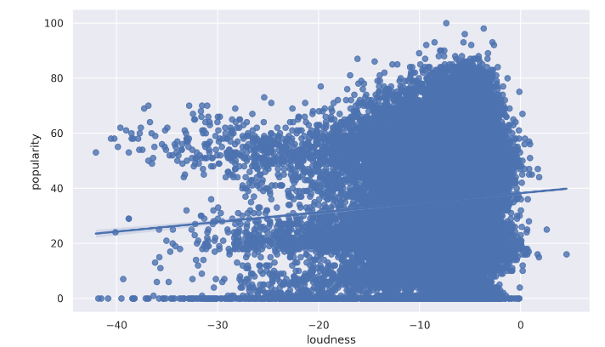
We used seaborn to plot some basic visualizations in the notebook of popularity vs loudness, danceability vs popularity, energy vs popularity & tempo vs popularity finding that loudness & popularity were most strongly correlated

Slide 6
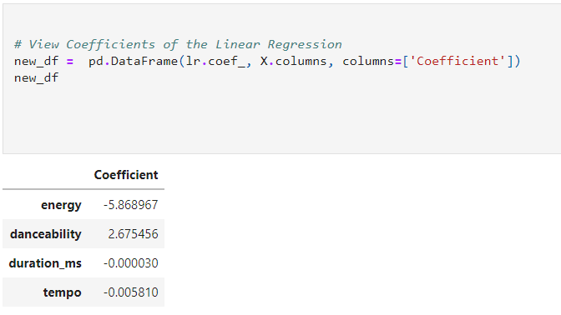
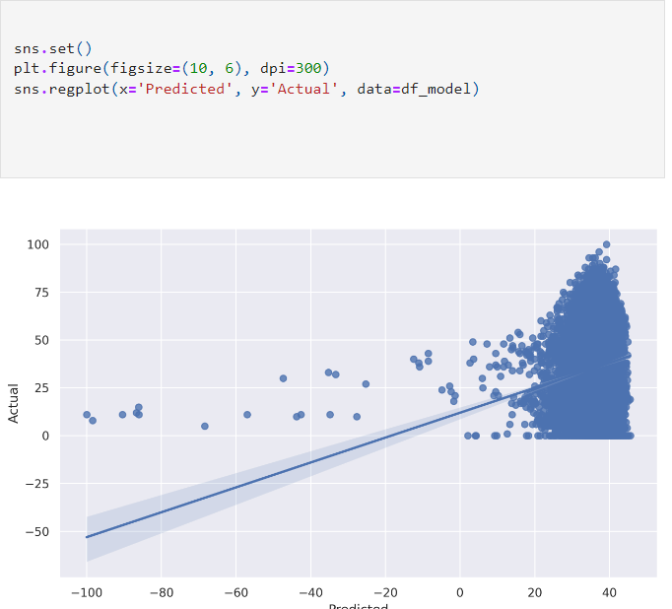
Using Machine Learning we then aimed to make some predictions around the data.

Slide 7
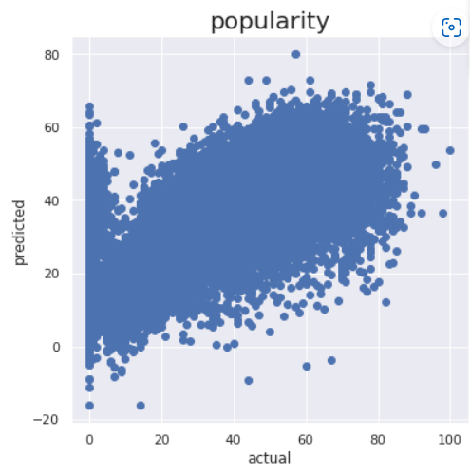
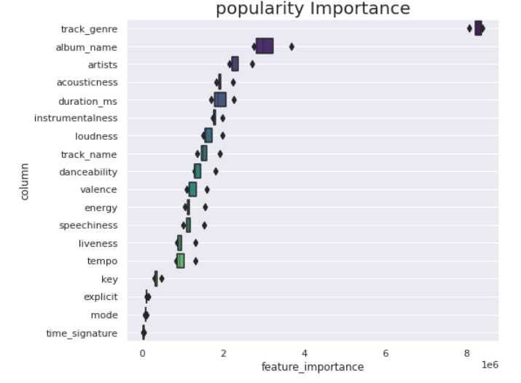
Using Kfold cross validation we split the data into 5 splits and then visualized this to look at popularity importance

Slide 8
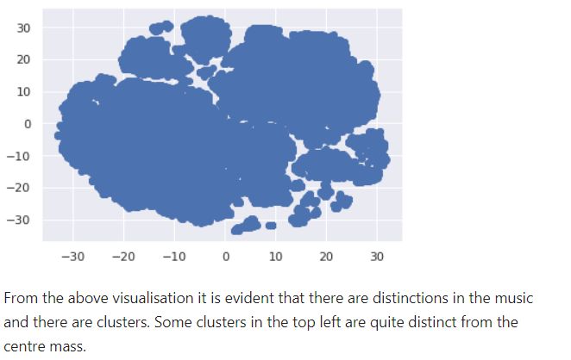
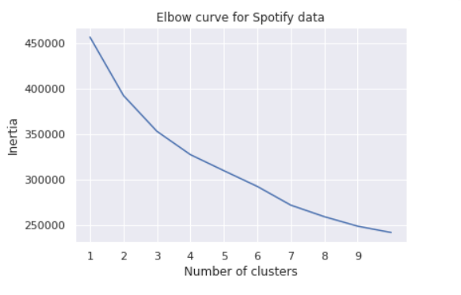
We then used StandardScalar to standardise the data and initiated the PCA model before transforming this PCA data into a dataframe. Using this dataframe we initialised the t-SNE model and created a plot to visualize the clusters as well as creating an elbow curve of the data

Slide 10
Following this we then migrated to Tableau Public to create further visualizations that are available at the following link

